Slide 1
Become Part of Excellence
OULU UNIVERSITY OF APPLIED SCIENCES

Slide 2
Oulu University of Applied Sciences (Oulu UAS) is one of the biggest universities of applied sciences in Finland. We educate competent and innovative professionals and do active research and development.

Slide 3
We provide bachelor and master degree programme studies, professional specialisation studies, pedagogic studies at the School of Vocational Teacher Education, Open University studies as well as supplementary training.

Slide 4
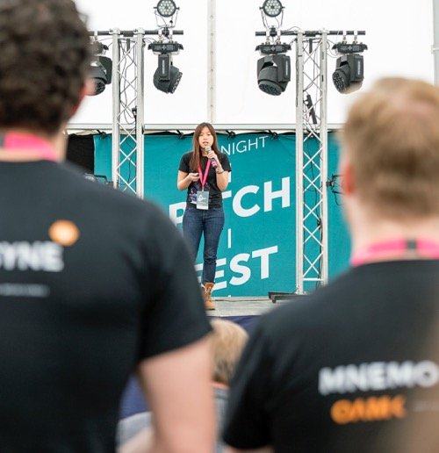
PROFILE: OULU UAS CONCENTRATES ESPECIALLY ON THE FOLLOWING FOCUS AREAS
Services and technology promoting health and well-being
Energy-efficient construction for the northern climate
Multidisciplinary business and entrepreneurship abilities
Up-to-date teachership at university of applied sciences and teacher training

Slide 5
Location

Slide 8
Studies at Oulu UAS

Slide 9
You can study in the fields of Business, Engineering, Health and Social Care, Information and Communication Technology, Media and Performing Arts or Natural Resources.

Slide 10
Two Degrees entirely in English: Oulu UAS offers professional higher education at Bachelor´s level in the fields of Business and Technology.

Slide 11
Annual Tuition fee was launched in Autumn 2017: 8,000 EUR (Possible grant 4,000 EUR)

Slide 12
Oulu UAS starting places in 2016
BACHELOR’S 1701 MASTER’S 135
NATURAL RESOURCES
Agrologist
MEDIA AND PERFORMING ARTS
Media artist Music pedagogue Musician
Dance teacher
BUSINESS
Bachelor of Business Administration, BBA
HEALTH AND SOCIAL CARE
Biomedical Laboratory Scientist Paramedic Physiotherapist Registered Nurse Public Health Nurse Midwife Optometrist Radiographer Bachelor of Social Services Dental Hygienist Occupational Therapist
ENGINEERING
Bachelor of Engineering, BEng
Bachelor of Construction Management
Construction Architect
In addition we offer Vocational Teacher Education , 60 ECTS credits

Slide 13
Subjects are very interesting and all the classrooms are well equipped. Overall we learn by doing not by memorizing theory.
MAITE ALAEZ-GUERGUE, INFORMATION TECHNOLOGY

Slide 14
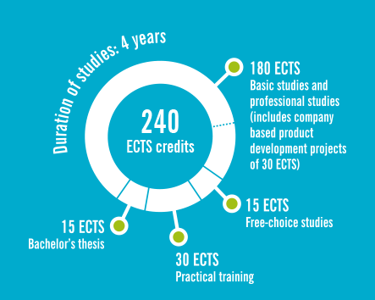
Information Technology (BEng)
The city of Oulu has been chosen among 10 most innovative cities in the world for several times in a row. Often referred to as "the silicon valley of Europe", Oulu is widely known for its ICT technology and innovations. This can also be seen in the field of technology at the school of Engineering. Students are able to apply for lAB studies, which have been developed to educate experts in game and cloud services.

Slide 15
Studies include a lot of team work and projects. VIKTORS SOBOLEVS, INTERNATIONAL BUSINESS

Slide 16
International Business (BBA)
The field of International Business is one of our most popular fields of study. It attracts hundreds of Finnish and international students every year. The degree programme offers up-to-date education in marketing, accountancy and multinational companies.

Slide 17
International Oulu UAS 2016
2 international Bachelor’s degree programmes
350 international degree students
180 international partner universities
536 outgoing and incoming exchange students (= 10 000 credits)
281 staff’s working periods abroad in 2016
264 foreign lecturers/experts to Oulu UAS in 2016
5 international research and development projects
staff/teacher exchange weeks yearly

Slide 18
Research, development and innovation

Slide 19
Research, development and innovation
Research, development and innovation (RDI) is one of the basic tasks of the university of applied sciences.
Oulu UAS’s RDI work serves teaching and supports the development of Oulu UAS, Oulu Region and the whole Northern Finland by producing skilled workforce, supporting business operations and developing innovation activities.
A big part of the RDI of Oulu UAS is directed through/to the Oulu Innovation Alliance
Starting points are real development needs of companies and other co-operation partners
Produces concrete results, for example
new know-how
new products, services or courses of actions
enhancing operations and cost savings

